Slide 1

Country Product Price Analysis: Mexico
Pyxeleados
Team:
Christopher Díaz
José Bermúdez
Christian Arroyo

Slide 2
Table of contents
1
Motivation and Project Summary
2
Questions & Data
Color Scheme
3
Data Cleanup & Exploration
223 125
FFDF7D
4
Data Analysis
24 57 112
183970
5
Discussion
10 95 180
0A5FB4
6
Post Mortem
67 202 229
43CAE5
7
Q&A
98 99 99
0 68 129
004481
Font Col.
0 0 0

Slide 3
1
Color Scheme
223 125
FFDF7D
Motivation and Project Summary
24 57 112
183970
10 95 180
0A5FB4
67 202 229
43CAE5
98 99 99
0 68 129
004481
Font Col.
0 0 0

Slide 4
The Reason
Hypothesis
The average prices for a certain category of products is different from location and store (chain) in México
Questions to solve
General Questions
Product Related Questions
Color Scheme
  What information should we use?
  What is the year with more product registry in the database?
  What is the category with more product data?
  Top 5 States, chains with the highest price and % of products sold per State and chain?
  Average price for the category and year selected in the Database?
  Dispersion of the average price vs. the average Top 5 states and chains with the highest price
223 125
FFDF7D
24 57 112
183970
10 95 180
0A5FB4
Answers?
General Questions
Product Related Questions
67 202 229
43CAE5
  The database from PROFECO (API) with prices of products
  Year 2015
  Category: Medicamentos (MEDICAMENTOS – API Name)
  State and chain with the highest price is Sinaloa and Farmacia del Hospital, and Walmart is the chain with the highest product offering.
  Ps.$ 379.6
  The top 2 chain and state with the highest dispersion are Sanborns and Mexico State
98 99 99
0 68 129
004481
Font Col.
0 0 0

Slide 5
2
Color Scheme
223 125
FFDF7D
Questions & Data
24 57 112
183970
10 95 180
0A5FB4
67 202 229
43CAE5
98 99 99
0 68 129
004481
Font Col.
0 0 0

Slide 6
What to Search For?
Data required to solve the questions
General Questions
Product Related Questions
  What information should we use?
    Selection of a database that includes information about products, State and historical data, this resulted in PROFECOs’ Database API
  What is the year with more product registry in the database?
    After reviewing the JSON file from the API we achieved a general understanding of the API’s data
  What is the category with more product data?
    Information of all the categories of products in Mexico to analyze trends and price behavior
    The database included this information and the resulting category is Medicines
  Top 5 States, chains with the highest price and % of products sold per State and chain?
    We searched for Price of each product from each category to calculate the average price per State and chain
    Look for the number of products with price registered by State and chain to calculate the average product registry per State and chain
  Average price for the category and year selected in the Database?
    Price of products from the selected category by year
  Dispersion of the average price vs. the average Top 5 states and chains with the highest price
    All data has been obtained to calculate the answer to this question
Color Scheme
223 125
FFDF7D
24 57 112
183970
10 95 180
0A5FB4
67 202 229
43CAE5
98 99 99
0 68 129
004481
Font Col.
0 0 0

Slide 7
3
Color Scheme
223 125
FFDF7D
Data Cleanup & Exploration
24 57 112
183970
10 95 180
0A5FB4
67 202 229
43CAE5
98 99 99
0 68 129
004481
Font Col.
0 0 0

Slide 8





Key to Our Analysis
Sources and key analysis
Color Scheme
223 125
FFDF7D
24 57 112
183970
Cleaning up the data
Download the data
Append the data and create CSV
Create a data frame cleaning the titles and information we do not require
Fix the data format (type)
Review the information
Clean the information with new findings
Interesting Insights
The lowest price pharmacies (chains) that sell medicines with the lowest price in the PROFECOs’ data base for 2015 are Farmacia Paris, Farmacias Similares, Farma Pronto, ISSEG among others
Wal-Mart sells the 16% of number of registered medicine brands and products in its stores
Problems and Limitations
Data consistency
Not frequently updated
Missing information from different states and products
No documentation
Data frames did not recognize all characters correctly even with the correct enconding
The results
Jupyter Notebook
10 95 180
0A5FB4
67 202 229
43CAE5
98 99 99
0 68 129
004481
Font Col.
0 0 0

Slide 9
4
Color Scheme
223 125
FFDF7D
Data Analysis
24 57 112
183970
10 95 180
0A5FB4
67 202 229
43CAE5
98 99 99
0 68 129
004481
Font Col.
0 0 0

Slide 10
Brain and Computing Power to Deliver
Breaking down the process
Sort the information
Find relationships in
the data
Get the right
metrics
Connect
the dots
Color Scheme
223 125
FFDF7D
Find out the date with more data in the dataset, the result was 2015
Sort the information to find the basic consumer product available in PROFECO’s API JSON file
Pick the category of products with more data in the dataset, the result was medicines
Analyze all information to see the potential trends behind the proposed questions and hypothesis to answer
We saw certain relationships regarding the data but with limitations from data consistency
After an exhaustive analysis we concluded that the right metrics to calculate were
Average price per State, category, chain, and total average price
Count of registries of products per State, category, chain, and total average price
What did we find…
24 57 112
183970
10 95 180
0A5FB4
67 202 229
43CAE5
98 99 99
0 68 129
004481
Font Col.
0 0 0

Slide 11
5
Color Scheme
223 125
FFDF7D
Finding’s Discussion
24 57 112
183970
10 95 180
0A5FB4
67 202 229
43CAE5
98 99 99
0 68 129
004481
Font Col.
0 0 0

Slide 12
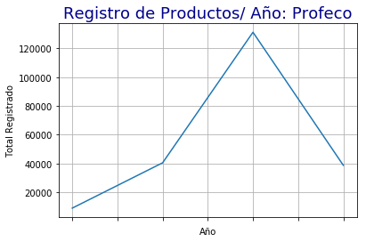
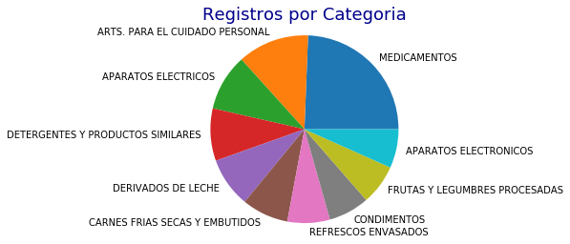
Interesting Things – The overview
There is a lack of update and newer information to choose from the PROFECOs’ data base
Product Registry / Year
Registry Entries by Category
Color Scheme
223 125
FFDF7D
24 57 112
183970
10 95 180
0A5FB4
67 202 229
43CAE5
98 99 99
0 68 129
004481
The data shows that the year 2015 is the year with the highest data points, reaching 131,192 registry entries, this represents 14.5x the year with lowest registry entries (2012)
The data shows that the year 2015 is the year with the highest data points, reaching 131,192 registry entries, this represents 14.5x the year with lowest registry entries (2012)
Font Col.
0 0 0

Slide 13
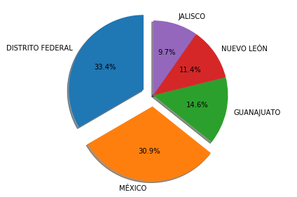
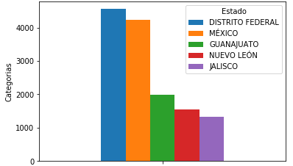
Interesting Things – The product offering
The most variety of products by the registration of products in the PROFECO’s data base seems to be Mexico City
Top 5 Categories by State
Top 5 Product % Share by State
Color Scheme
223 125
FFDF7D
24 57 112
183970
10 95 180
0A5FB4
67 202 229
43CAE5
The Distrito Federal is the State with more registered products than any other state with 4,558 medicine products, following the Mexico State, Guanajuato, Nuevo Leon and Jalisco
This information does not imply that this conclusion is definitive because there exist an inconsistency and frequency of the data provided by the Mexican Government Entity PROFECO
The Distrito Federal has the 33.4% of all registered products, following by Mexico State with 30.9%, this two State represent more than half (with 64.3%) of all the registered products according to PROFECOs’ data
This two leading States represent:
4.4x the registrations in Guanajuato
5.6x the registrations in Nuevo Leon
6.2x the registrations in Jalisco
98 99 99
0 68 129
004481
Font Col.
0 0 0

Slide 14
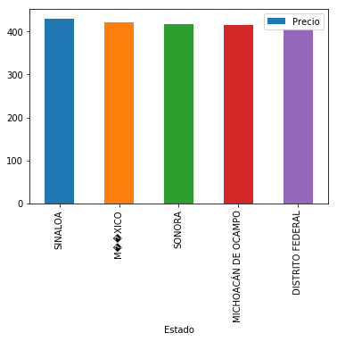
Interesting Things – The Extras: Part I/II
The highest price is from the top 5 States is found in a higher proportion in northern than in central or southern States
Top 5 Average Highest Price by State
Top 5 Price by State vs. Average Price (Meds)
Sinaloa
113.3%
Color Scheme
Mexico State
111.0%
Sonora
109.8%
-5.7%
223 125
FFDF7D
Michoacan
109.4%
24 57 112
183970
Distrito Federal
106.9%
10 95 180
0A5FB4
67 202 229
43CAE5
Sinaloa’s medicine average price is 13.3% higher than the average price, Mexico State 11.0% higher, Sonora 9.8% higher, Michoacan 9.4% higher and Distrito Federal 6.9% higher price
The average price does not show a clear pattern with income level per capita or population count, this could be an impact from data inconsistency
The average dispersion between the top 5 highest prices by State is c.10%
98 99 99
0 68 129
004481
Sinaloa is the state with the average highest price in the Mexican Republic with Ps.$ 430.2, followed by Mexico State with 421.2, Sonora with Ps.$ 416.8, Michoacan with Ps.$ 415.3 and Distrito Federal with PS.$405.8
Font Col.
0 0 0

Slide 15
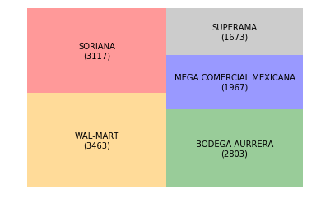
Interesting Things – The Extras: Part II/II
How about the supermarket chains and pharmacies?
Top 5 chains that sell the most registered products
Top 5 Highest Price by Chain vs. Average Price (Meds)
Color Scheme
23.9%⁽¹⁾
12.8%⁽¹⁾
Farmacia del Hospital
141.2%
223 125
FFDF7D
Sanborns
124.2%
15.1%⁽¹⁾
24 57 112
183970
Farmatodo
122.5%
-15.5%
26.6%⁽¹⁾
21.5%⁽¹⁾
10 95 180
0A5FB4
ISSSTE
119.7%
This Top 5 Chains represent a 9.9%⁽²⁾ of all registered products in the Medicines category for the year 2015
Supermercados Santa Fe
119.3%
67 202 229
43CAE5
The highest price comes from Hospital pharmacies (inside hospitals), followed by Sanborns with 24.2% higher price than the average, Farmatodo with 22.5%, ISSSTE with 19.7% and Supermercados SF with 19.3%
98 99 99
0 68 129
004481
Font Col.
0 0 0
Notes: (1) This is the proportion vs the TOP 5 total registered products ( 13,023 products): (2) the total registered products in 2015 is 131,192 products

Slide 16
6
Color Scheme
223 125
FFDF7D
Post Mortem
24 57 112
183970
10 95 180
0A5FB4
67 202 229
43CAE5
98 99 99
0 68 129
004481
Font Col.
0 0 0

Slide 17
Limitations
We found several limitations and caveats in the data base we used
1
Analysis was conducted based on 2015 not current year, caused by a lack of frequent update of the information
2
Inconsistency of registries per year (2015 had significantly more registries than the rest of the years in the data frame)
Color Scheme
223 125
FFDF7D
3
Incomplete information for some categories. (Medicines had the largest number of registries). Some other categories lack information
24 57 112
183970
4
API had little to no documentation (We had to download the whole database)
10 95 180
0A5FB4
5
67 202 229
43CAE5
Time series analysis limited because of inconsistency of data through time
98 99 99
6
We don’t have visibility of # of products registered with PROFECO vs. # of products in the market
0 68 129
004481
7
Font Col.
There is some information missing when going into detail (Example: Brand)
0 0 0

Slide 18


What’s Next?
This ideas surged in the process of cleaning and analyzing the information
Price evolution vs. GDP per capita growth and average household expenditure in Medicines
Relationship vs. past year price and product registry evolution
Color Scheme
223 125
FFDF7D
24 57 112
183970
10 95 180
0A5FB4
Relationship between registered products vs. current products in the market
Relationship vs. past year price and product registry evolution
67 202 229
43CAE5
98 99 99
0 68 129
004481
Font Col.
0 0 0

Slide 19
7
Color Scheme
223 125
FFDF7D
Q&A
24 57 112
183970
10 95 180
0A5FB4
67 202 229
43CAE5
98 99 99
0 68 129
004481
Font Col.
0 0 0

Slide 20
Fire your questions
Thank you
Color Scheme
255 223 125
24 57 112
67 202 229
98 99 99
242 242 242
Font Col.
0 0 0

